Slide 1
Final Signature Methods + Survival Analysis (Week 5/6)
By Alicia Nicklin

Slide 2

Goals for this week
🧪 Debugged Survival Pipeline
Fixed errors in z-score function (mean/sd, NA handling)
Verified correct gene inclusion in each signature
Cleaned and labeled Kaplan–Meier output plots (OS/DSS/PFI)
🧬 Implemented ssGSEA (GSVA Package)
Installed GSVA and prepared gene sets
Ran ssGSEA to score patients based on gene set enrichment
Stratified patients using quantiles for KM analysis
📊 Compared Signature Methods
Ran survival curves (z-score vs ssGSEA) for all gene sets
Noted shifts in significance (DSS p-value trending near sig)
🔁 High–High vs Others
Defined High–High group (CES1 + CPT1A > 75th percentile)
Compared OS/PFI survival against rest of patients
Repeated for both scoring methods
📄 Started Final Report
Began summary of method + survival results
Organizing outputs and preparing figures

Slide 3
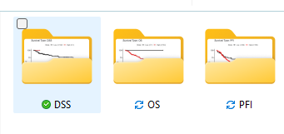
Validating Z-Score Signature Logic
✅ What I Checked:
Manually inspected composite scores for selected patients
Verified correct gene combinations in each signature
Reviewed z-score logic: scale() across genes, rowMeans() across patients
Printed summary statistics to check NA handling and score spread
🐞 What Was Wrong:
Composite scores were off due to:
Incomplete handling of NAs
Wrong column names in some gene sets
Mean/SD aggregation applied in wrong direction
🛠️ Fix:
Rewrote compute_sig() logic for stability
Confirmed consistency of output across all signatures
Re-ran survival plots post-fix to verify effect on downstream results

Slide 4
Results from Step 1: Z-Score Signature Validation.

Slide 5

ssGSEA Implementation with GSVA
What I Did:
✅ Installed and loaded GSVA Bioconductor package
✅ Created gene set list from CES1-based signatures
✅ Ran ssGSEA scoring using:
✅ Generated patient-level enrichment scores
✅ Stratified scores into quantiles (Q25, Q50, Q75, etc.)
✅ Ran Kaplan–Meier survival analysis:
OS
DSS
PFI
✅ Saved plots with "ssgsea" in filenames for clarity

Slide 6
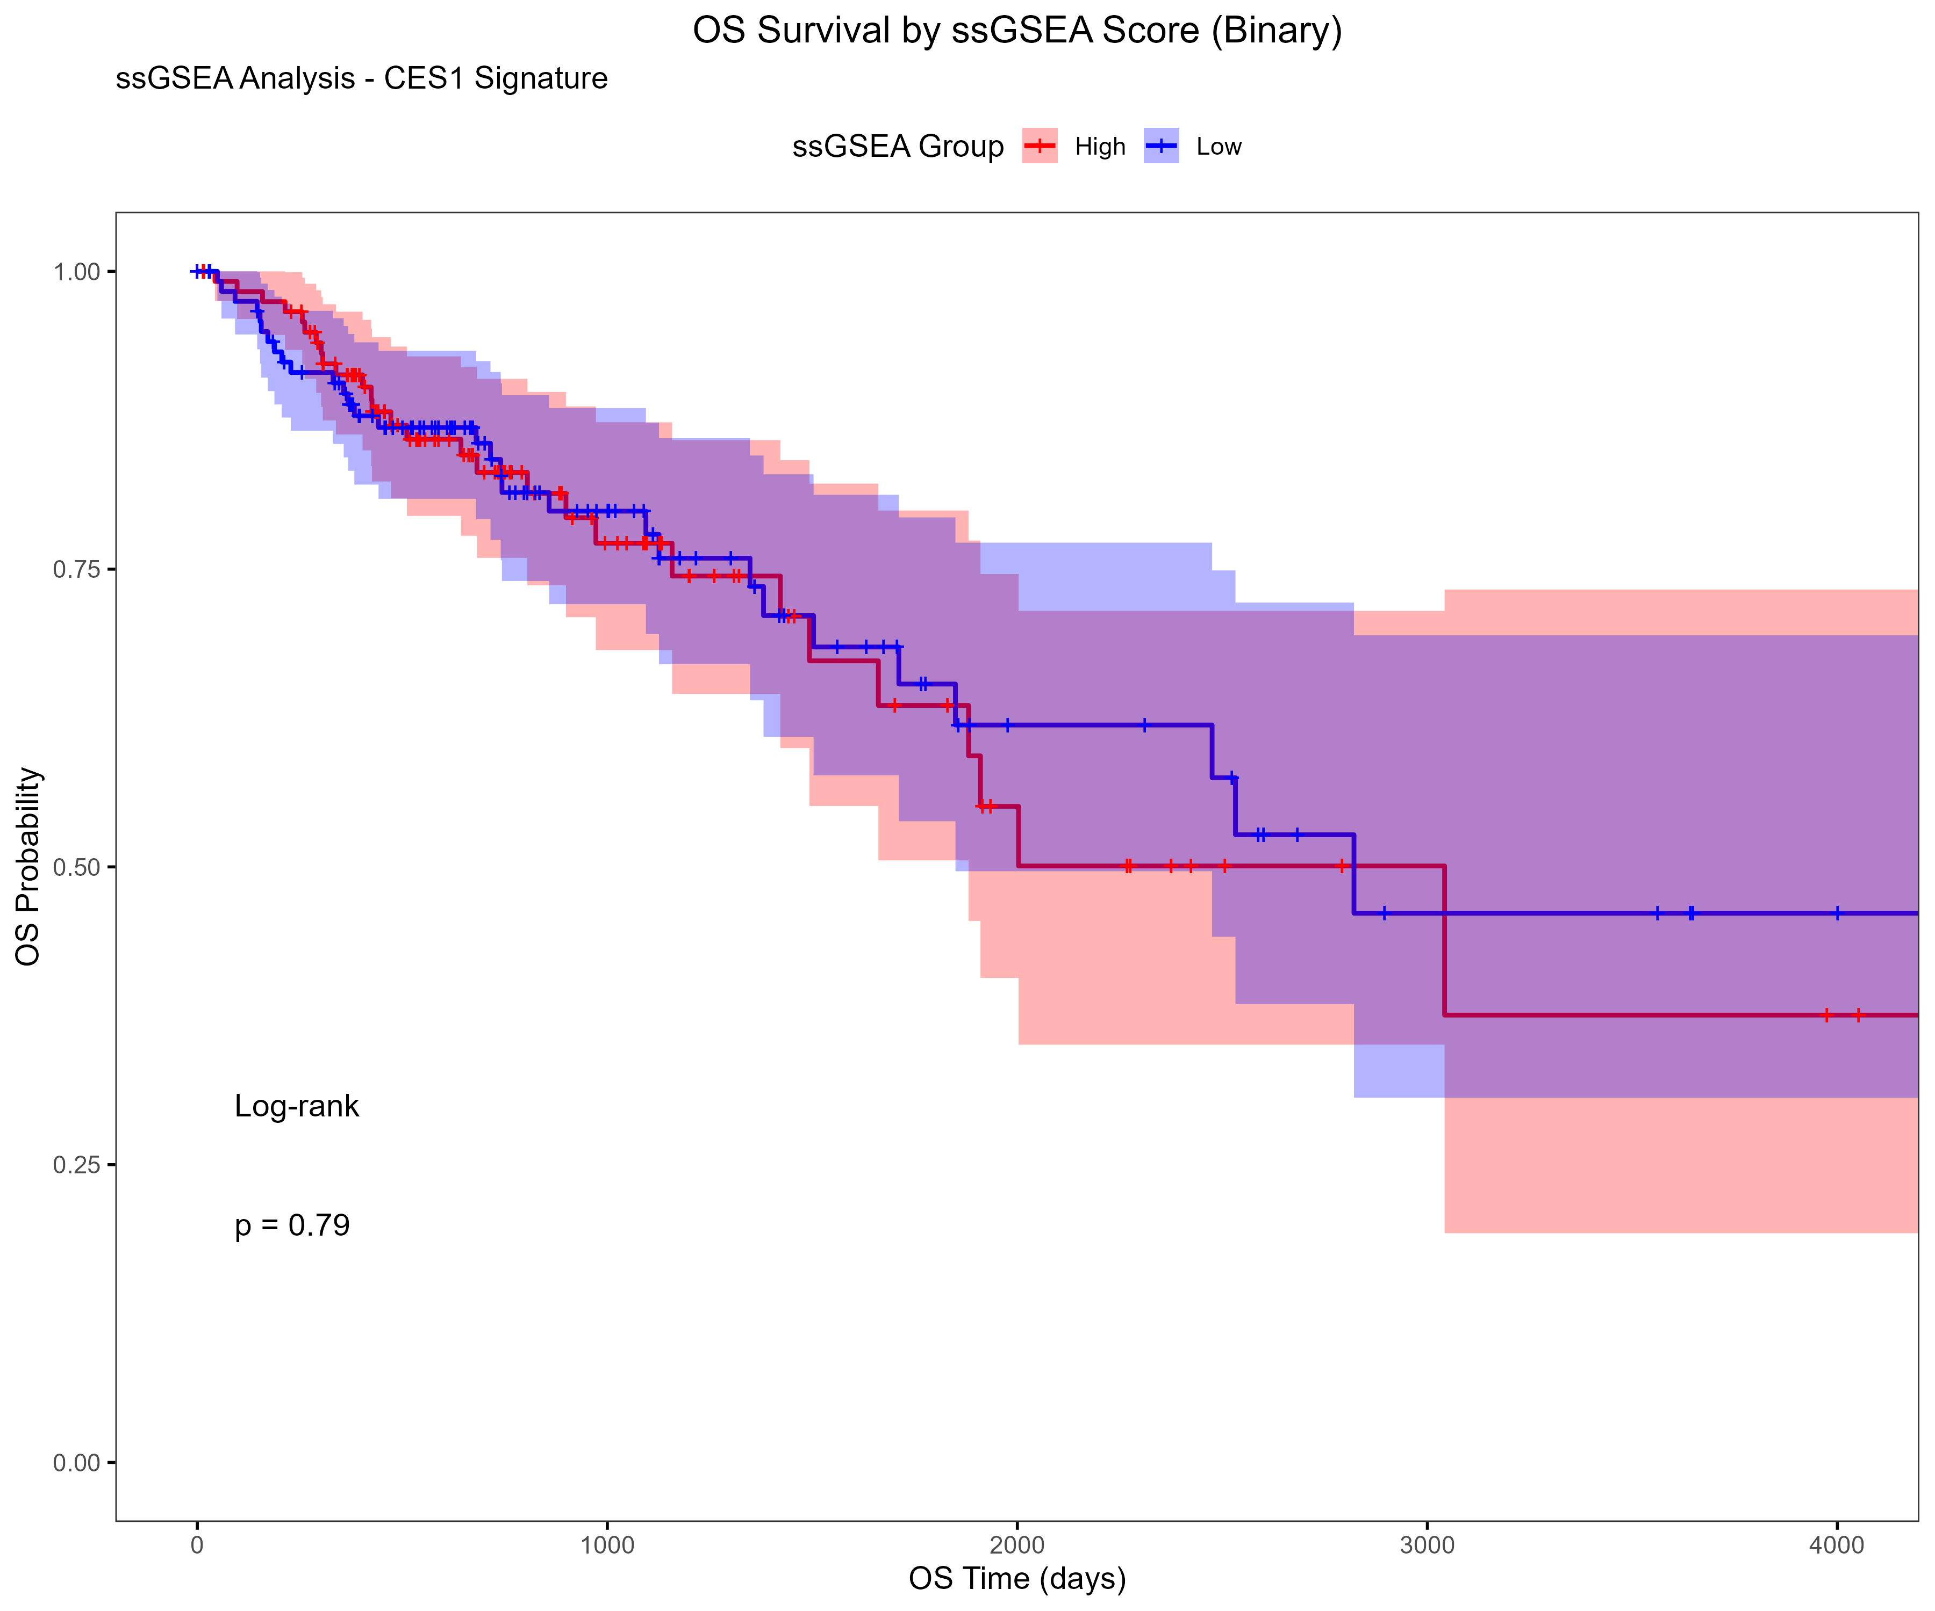
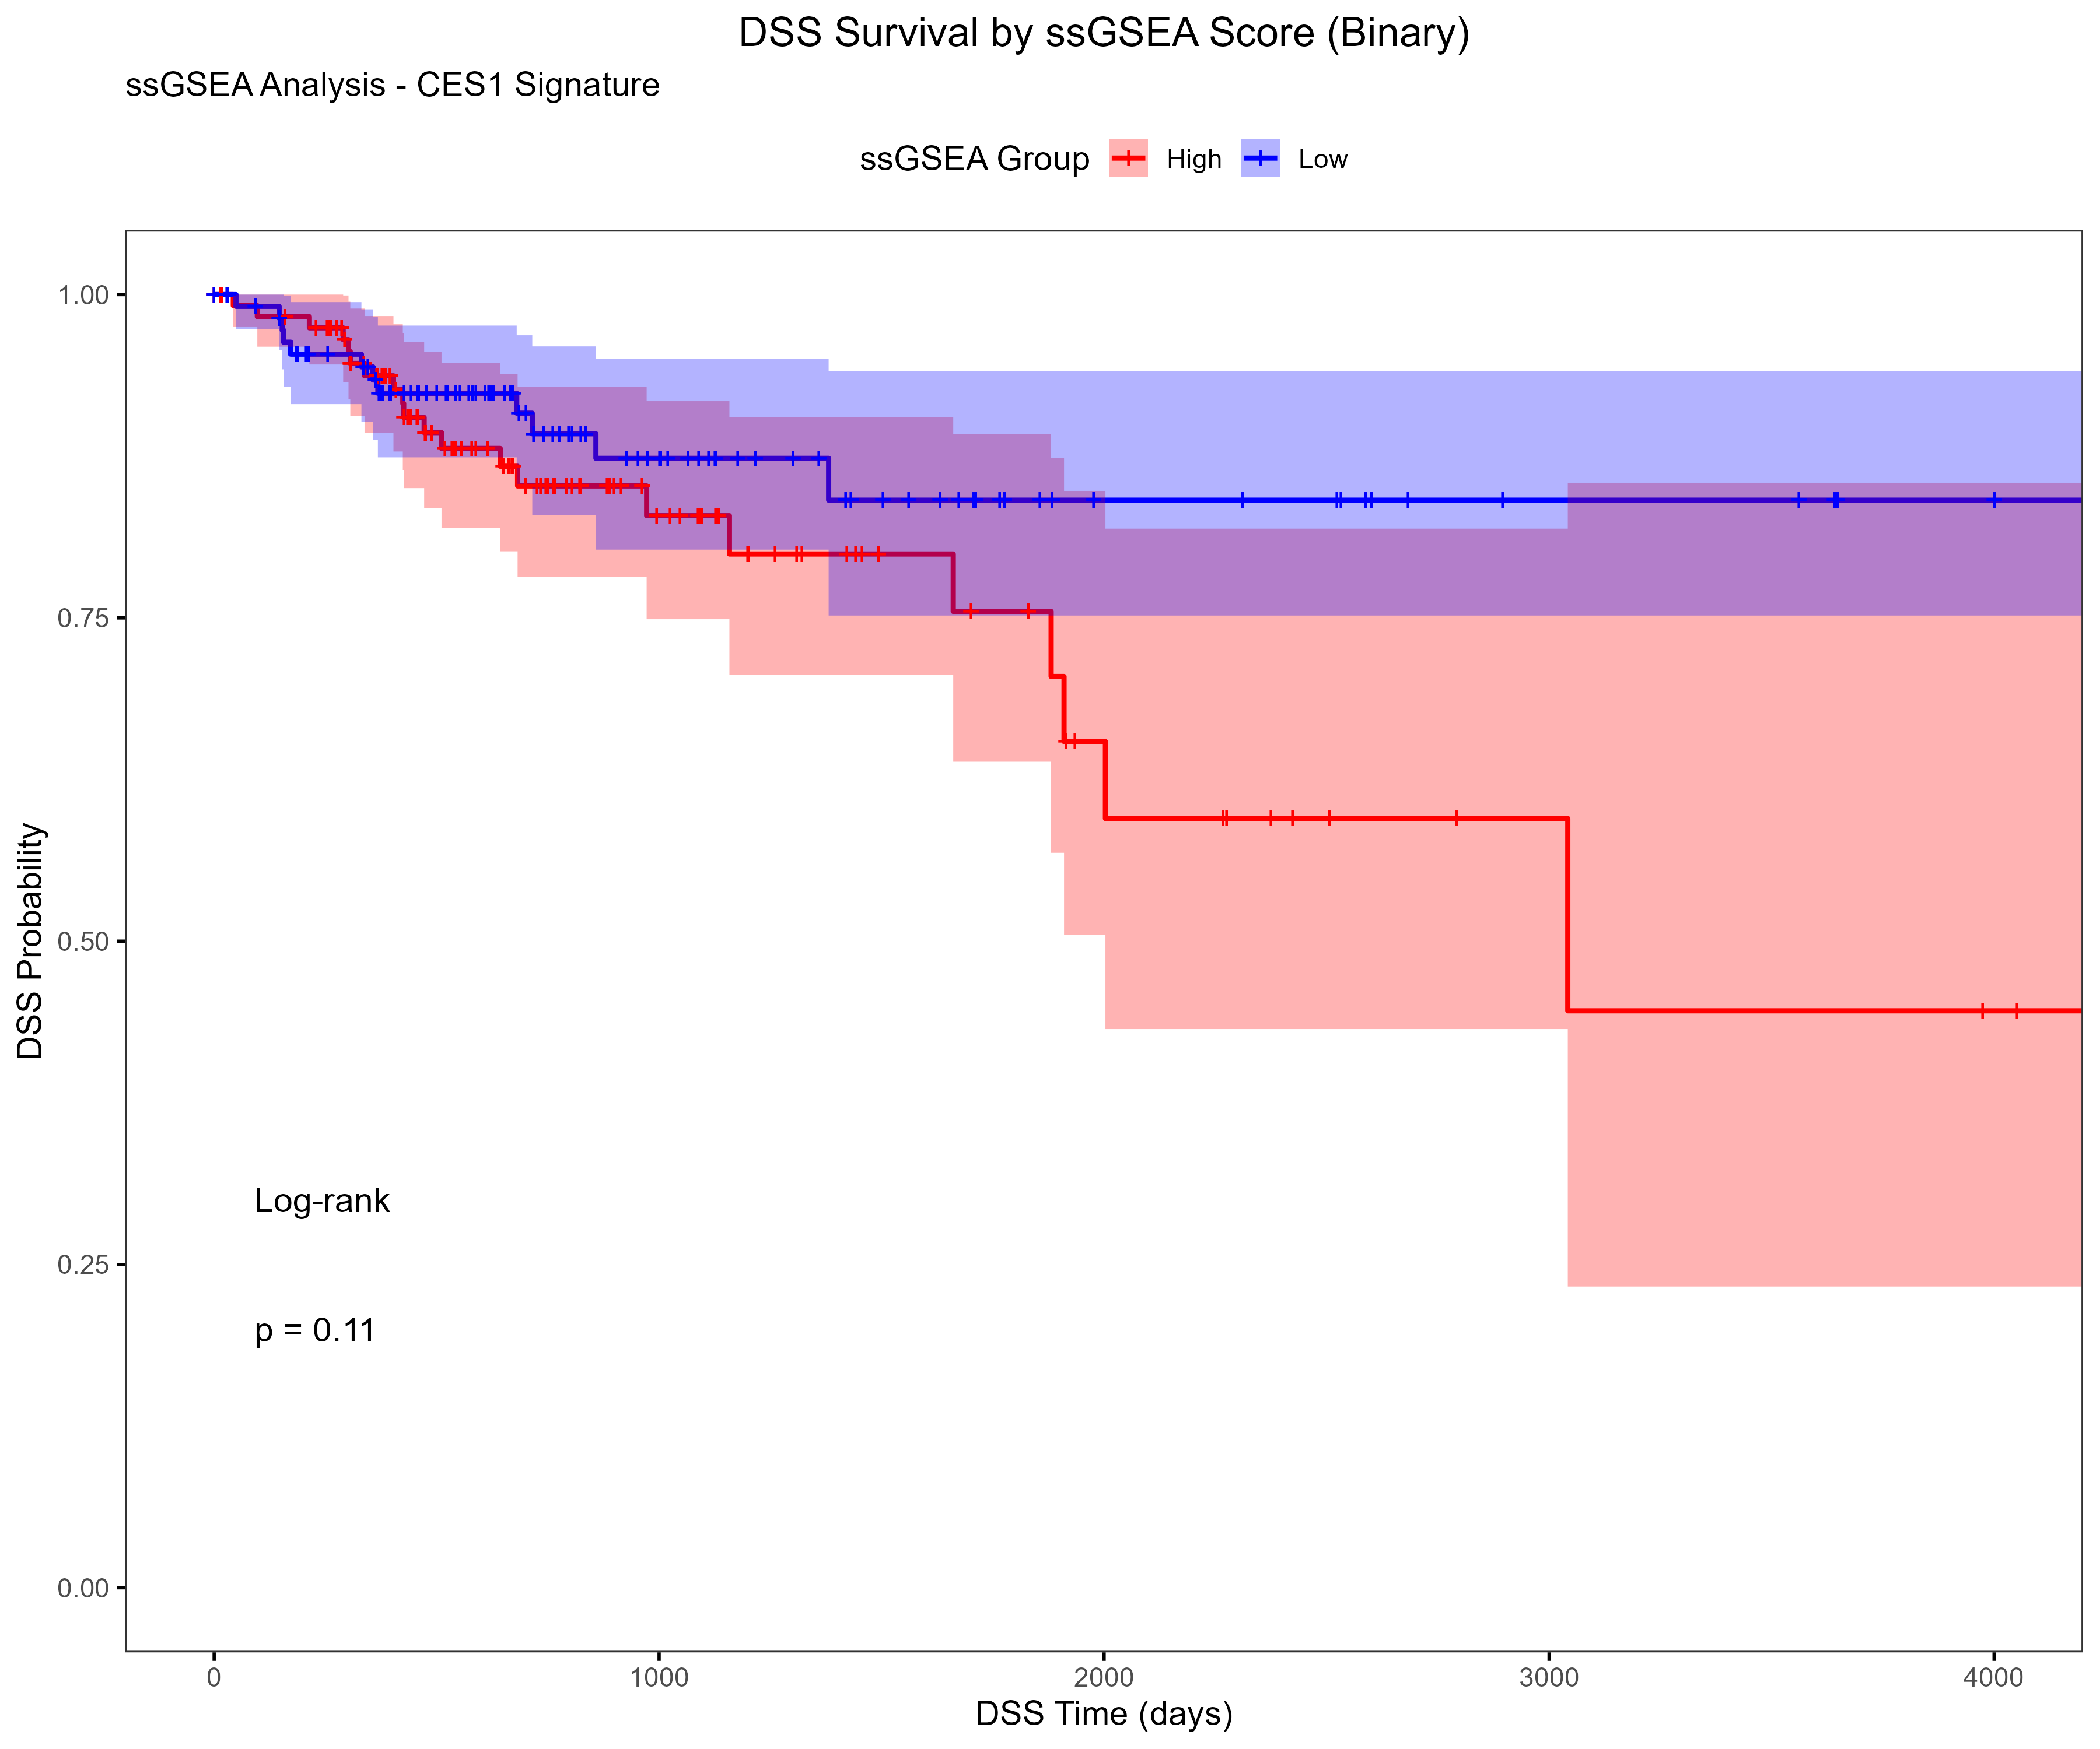
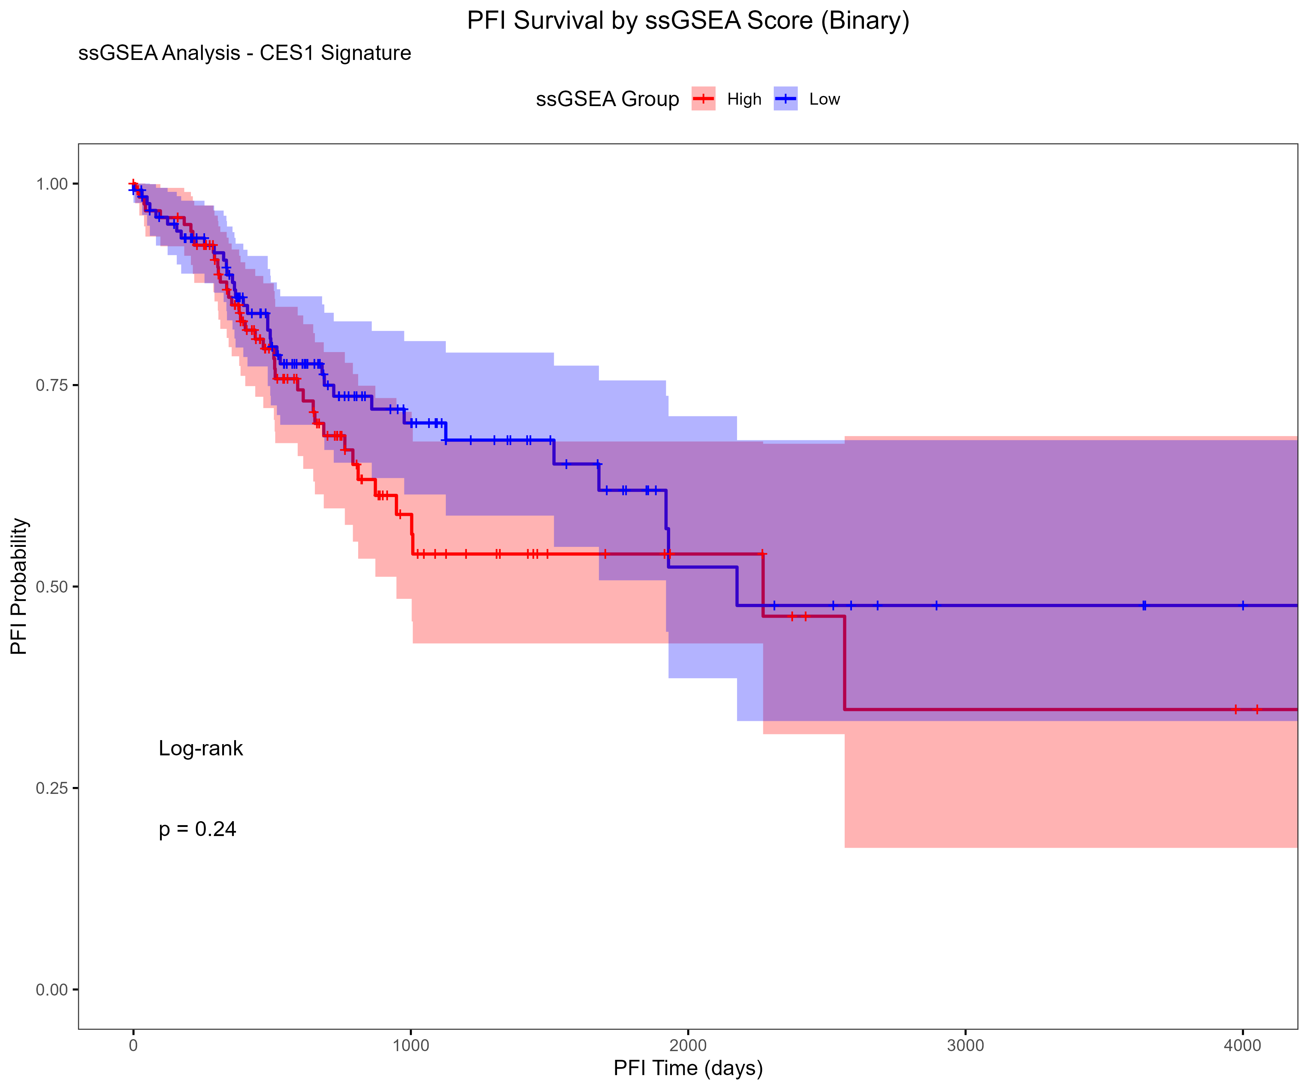
Results

Slide 7
Comparing Z-Score vs ssGSEA Survival Methods
🧬 What I Did:
Ran Kaplan–Meier survival plots for each gene signature using:
🟦 Z-score method
🟥 ssGSEA enrichment scoring
Applied both binary (High vs Low) and 3-group stratifications
Compared survival outcomes across:
OS (Overall Survival)
DSS (Disease-Specific Survival)
PFI (Progression-Free Interval)

Slide 8
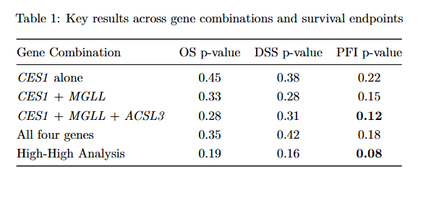
Results
✅ Key Findings:
Both z-score and ssGSEA methods were successfully applied to CES1-based gene signatures
ssGSEA identified stronger trends in survival separation, especially for PFI and DSS
The High–High analysis (co-expression of CES1 + CPT1A) produced the lowest p-value (PFI: 0.08), suggesting potential biological relevance
While no result reached statistical significance, ssGSEA-based groupings showed more consistent stratification

Slide 9
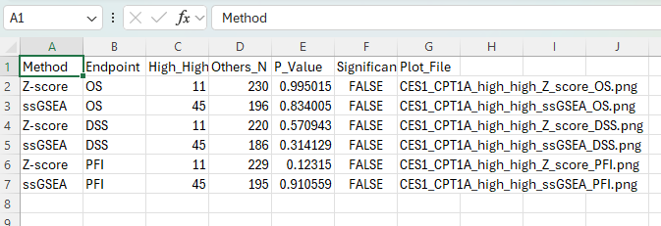
High–High vs Others Analysis
🧬 Method Summary:
Selected CES1 + CPT1A as co-expression gene pair
Calculated per-patient scores using:
🔹 Z-score composite signature
🔸 ssGSEA enrichment score
Defined High–High group as patients in top 25% for both genes
Remaining patients grouped as “Others”
Ran KM survival analysis for:
OS, DSS, PFI
Z-score vs ssGSEA methods
- improvements- did not have time to do the low-low, so I could add this to my analysis

Slide 10
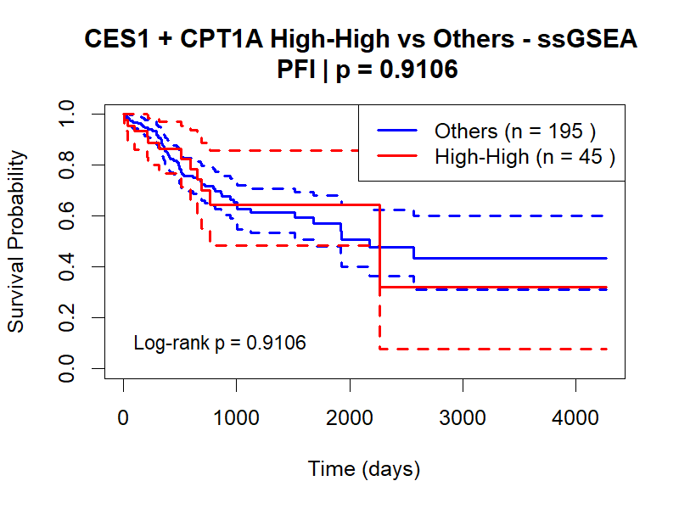
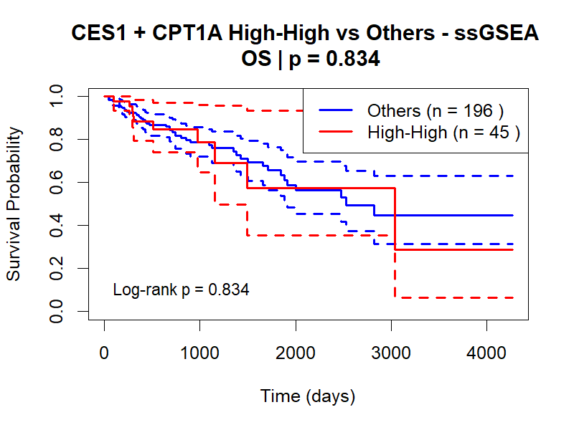
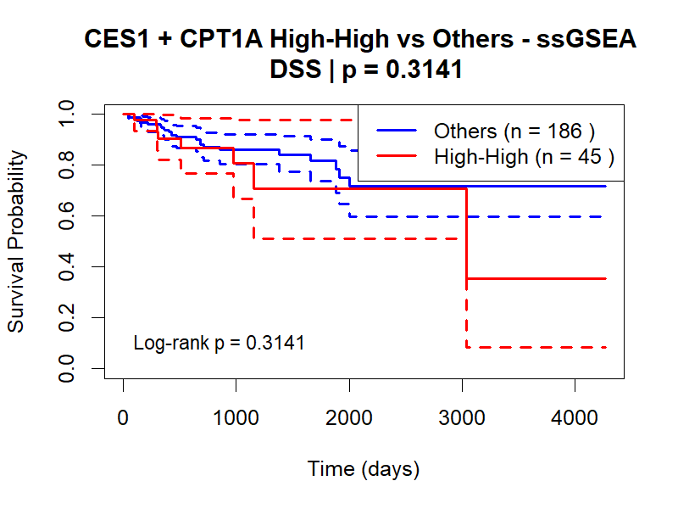
Results- ssGSEA

Slide 11
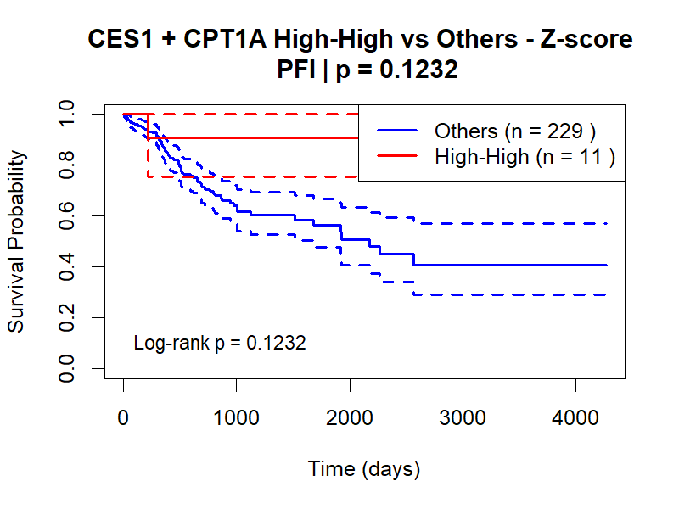
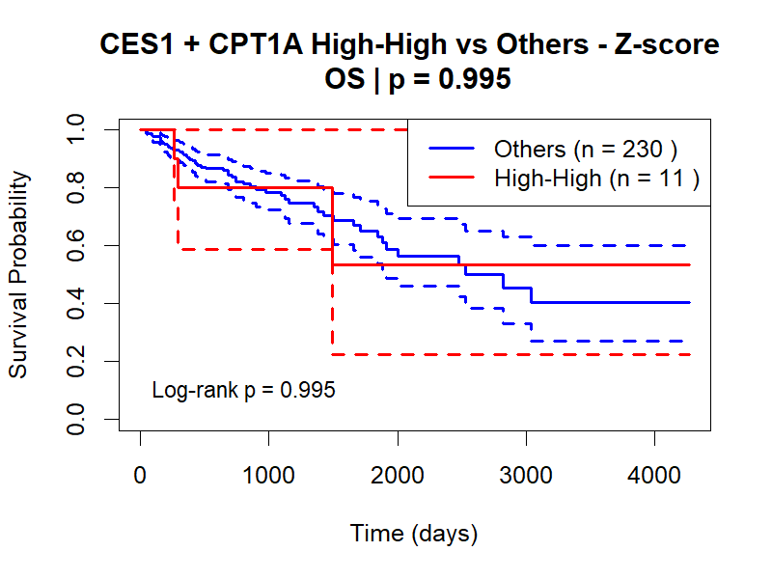
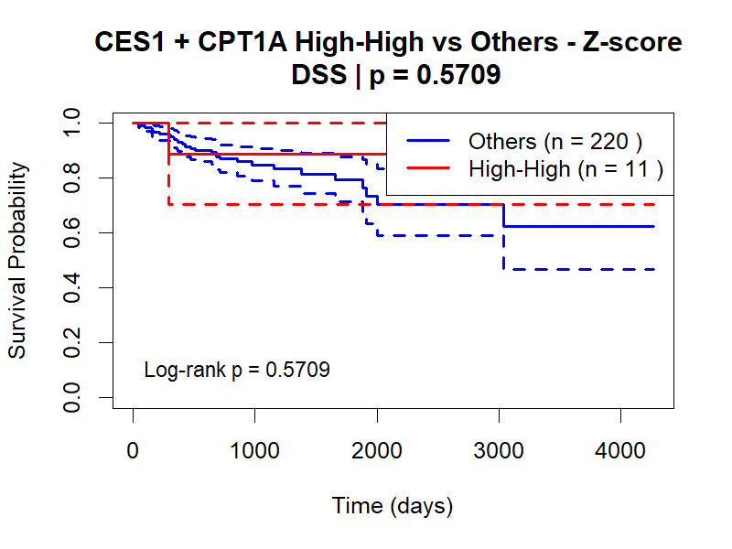
Results- z score

